Slide 1
Agriculture and Rural Transformation: Process and Lessons Learned
M. A. SATTAR MANDAL
Emeritus Professor of Ag. Economics
Bangladesh Agricultural University, Mymensingh
asmandal11@gmail.com
Plenary presentation at the 10th ASAE International (Virtual) Conference on “Gearing Asian Agriculture under the Fourth Industrial Revolution: Opportunities and Challenges”, Beijing, China, 6-8 December 2021.

Slide 2
Comparisons of Some Asian Countries
Source: Yield of rice data collected from FAO stat link: https://www.fao.org/faostat/en/#data/RL
Average farm size data taken from Our World in Data Link: https://ourworldindata.org/farm-size

Slide 3
Comparisons of Some Asian Countries (contd.)
Source: Data collected from World Bank Open Data website link: https://databank.worldbank.org/source/world-development-indicators#

Slide 4
Per capita productions in Bangladesh: 1972-73 to 2018-19
 | 1972-73 | 2018-19
Arable land (dec) | 28 | 10
Foodgrain (kg) | 140 | 235
Meat (kg) | 3.4 | 44
Milk (Kg) | 6.3 (1975-76) | 58
Eggs( No.) | 15( 1975-76) | 101
Fish (kg) | 11 (1974-75) | 25
Sources: BBS Statistical Pocket Diary 1979, Navin et al. 1989, Hamid 1993, Bangladesh Orthonoitik Somikkha 2018, Krishi Diary 2020.

Slide 5
Food production in Bangladesh

Slide 6
Transformation from Subsistence to Commercial Agriculture
Market penetration of technologies
- Irrigation water market (Palmer-Jones, 2001; Wood & Palmer-Jones, 1991; Mandal, 1987, 1993)-competitive, small farmer’s access, productivity enhanced.
- Land tillage service market services- LSPs, repair service market, local manufacturing (Alam, 2018, 2020, 2021).
-Combine harvester service market (Alam, 2021) – custom hiring market, some CH with remote sensor ( ACI Ltd., 2021).
- Diversification- shift from rice to aquaculture, orchard, vertical farming.

Slide 7
Major Policy Shifts for Transformation of Bangladesh Rural Economy
Large-scale privatization of agriculture since late 1980s- rapid growth of small engines (Mandal, 2017, Justice & Biggs, 2020).
Greater emphasis on commercialization of crop and non-crop agriculture with high value enterprises (successive Five-Year Plans, National Agriculture Policies, 2014, 2018).
Policy and budgetary support for scale appropriate mechanization (National Agricultural Mechanization Policy, 2020).
Policy support to main actors- rural entrepreneurs, service providers, private agro business (Pran, ACI, Metal, Alim industries, seed companies).
Budgetary support to agricultural R&D system.

Slide 8
Leading Agro/Rural Entrepreneurs
- Irrigation water sellers 1.9 mil.
-Tractor service providers (LSP) 35,000
- Power tiller service providers LSP 0.7 mil.
- Combine harvester LSP 5,000
-Threshers LSP 370,000
-Other small equipment LSP Numerous
Ag machinery market Tk. 104 bil.
Service market-20,000, R&M workshops,Tk 3.2 bil.
Rural mechanics 0.5 mil.
Diesel market for ag machinery- 1543 mil liter,
(Tk. 100 bil), diesel dealers/ retailers.
Source: Courtesy, Alam, M. (2019)

Slide 9
Leading Agro- Entrepreneurs(cont.)
Commercial dairy farmers- 65,000
30% run 50+ cows, 50% run 10+ cows
Cattle meat farmers, 5 lakh- 20% keep10+ cattle
Commercial poultry farmers- 81,000 (DLS),
140,000 (BPICC)
Poultry hatchery + breeder farms- 216 (+gov 45)
Private fish hatchery operators – 800 (Approx.)
Commercial fish farmers- 20,000 (Approx.)
Feed mill/ Fish feed company- 232
Source: Courtesy, Dr. Ainul Haq, Ex DG, DLS;
Prof. Dr. M. A. Wahab, WorldFish, Bangladesh.

Slide 10
Main Lessons Learned
Macro policy interventions- Decreasing role of public sector and increasing role of private sector in input distribution, mechanization process and output marketing.
Bangladesh has not followed the ‘Punjabi model’ of green revolution- big farms, heavy subsidy, lumpy machines etc.
Home grown model-small farm size with high fragmentation and land tenancy has not paused any big constraint e.g. ‘operational consolidation of fragmented holdings’ by local service providers (LSPs) to achieve economies of scale.
Agricultural mechanization has been largely unsubsidized, except for a few large expensive machines and fertilizers (e.g. around 5% of national budget).
Bangladesh has averted long discoursed ‘distributive land reform’ or cooperatives or collectivization, and pursued agrarian intensification forced by scarcity of arable land

Slide 11
Big Challenges Ahead
Weak linkages- Supply/ value chain development, nascent import dependent food industries, post- harvest technologies etc.
Financing agriculture- banking channels slow but have resources, non-banking channels fast but have limited resources.
Meeting challenges of urbanization or ‘rurbanization’, especially minimizing extreme pressure on arable land for rural industries and infrastructure.

Slide 12
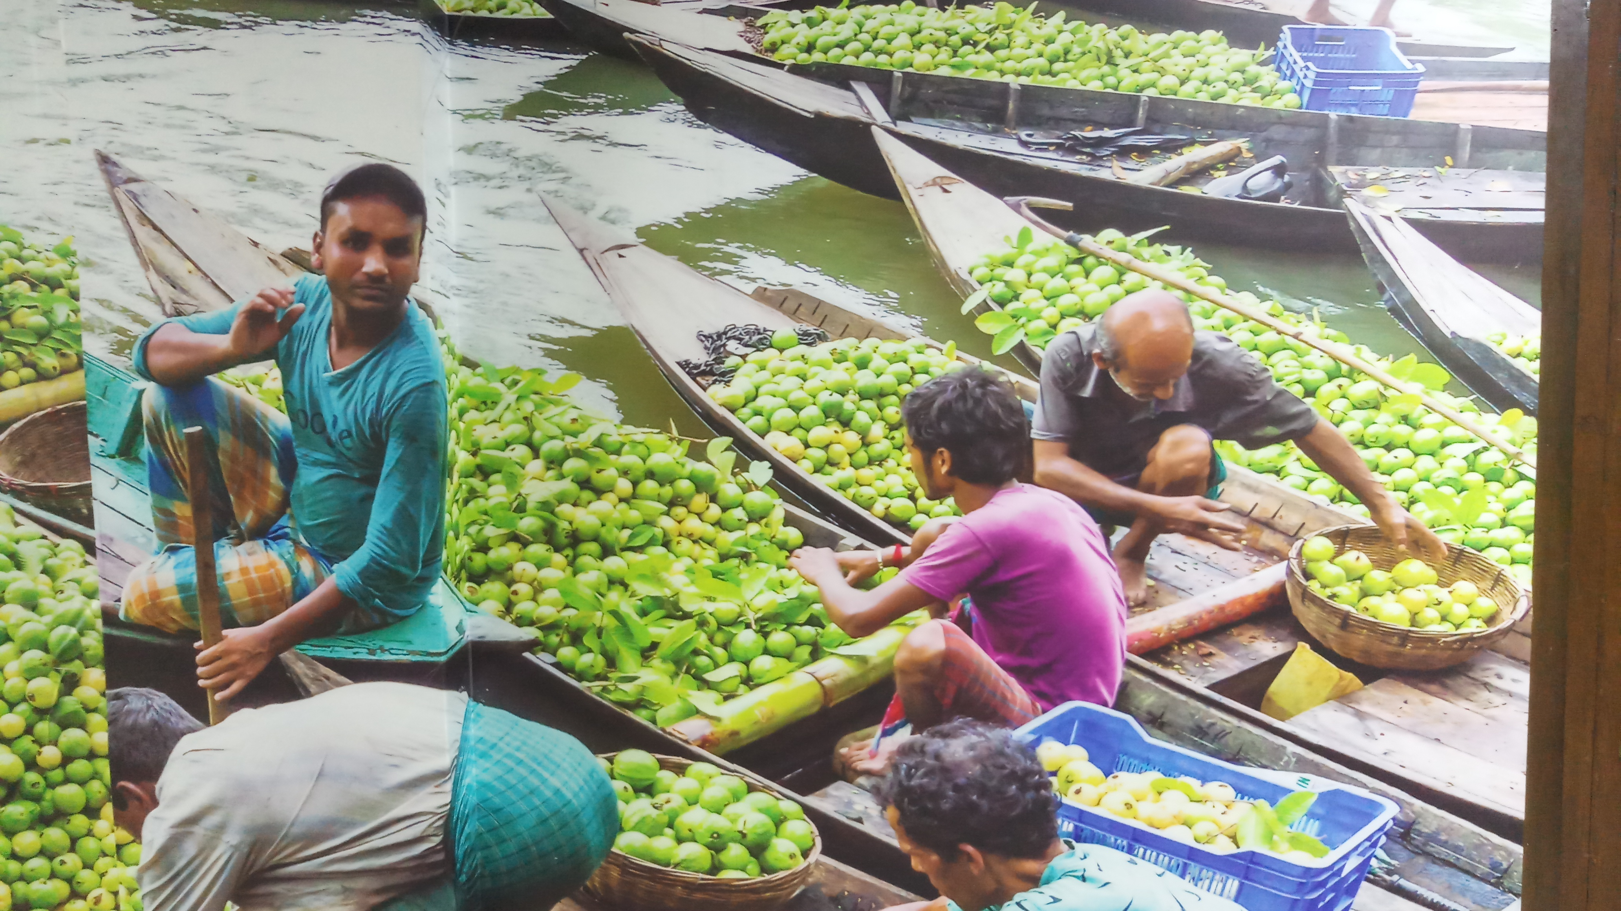
Thank you All
Thank You

