Slide 1
International Trade’s Role in Enhancing Food Security in Asia
Kym Anderson
University of Adelaide and Australian National University
kym.anderson@adelaide.edu.au
10th Conference of the Asian Society of Agricultural Economists
(Gearing Asian Agriculture under the Fourth Industrialization Revolution),
Beijing (and virtual), 6-8 December 2021

Slide 2
The trade-food security issue
Ensuring national and global food security is ever-more challenging
Global growth in population and income
Climate change => lower & more-volatile yields
Rising income inequality in many countries
A more-uncertain global trade environment
Agriculture is expected to contribute more
but to do so more sustainably and inclusively
and with healthier, more-nutritious food

Slide 3
Outline of presentation
Why open food markets to int’l trade?
How open are Asia’s food markets?
How to reform food policies to better achieve national food security and related societal objectives?

Slide 4
Why have open food markets?
International trade multiplies gains from intra-national production specialization and market exchange, due to national differences in:
Relative factor endowments
Production technologies
Consumer preferences
Seasons (in the case of fresh foods)
Food varieties and qualities
Also dynamic gains from trade: increased competition from openness stimulates innovation & productivity growth

Slide 5
Globalization has contributed greatly to a long period of global progress
We can celebrate massive declines in:
global poverty (Ravallion 2016, Atkinson 2019)
ill-health globally (Deaton 2013)
across-country income inequality (Milanovic 2016)

Slide 6
But globalization is sometimes blamed for other adverse outcomes
Rise of inequality of income, wealth and health within countries has been unwelcome (Stiglitz 2012, Bourguignon 2015)
as have global environmental and health problems
climate change, biodiversity loss, COVID, …

Slide 7
Globalization has become less popular
Distributional outcomes of latest globalization wave and digital revolution are faster, less predictable, and less equal than in previous waves (Baldwin 2016)
Has led to populism: world had more populist governments in 2010s than in any previous decade since 1900

Slide 8
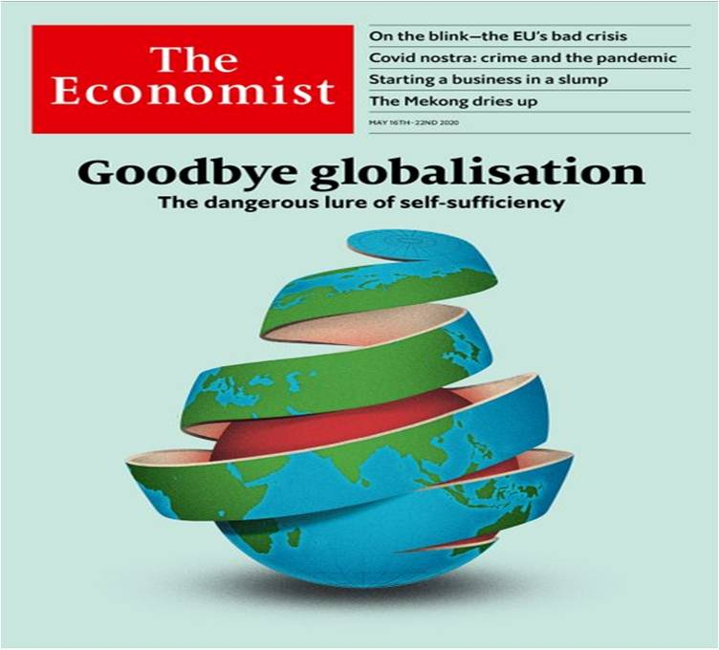
Rise of populist protectionism
… and populism leads to economic nationalism and protectionism
(Funke, Schularick & Trebesch, CEPR DP, 2021)

Slide 9
Why openness to food trade still matters, despite some new protectionism elsewhere
Standard gains from trade, due to:
Production specialization, esp. now with GVCs
More competition => faster productivity growth
Less unstable food accessibility, esp. now with greater crop yield volatility thanks to climate change
Possibly less inequality, poverty, environmental damage
provided optimal environmental policies are in place
Health gains from food trade openness
More intra-industry int’l trade, to exploit differences in seasons, or product qualities or varieties
=> greater diet diversity, food safety and quality, demands for which rise with per capita income

Slide 10
Comparative advantage in food
Depends heavily on national endowment of ag land relative to industrial capital
Low-income countries with rel. little non-farm capital have an ag comparative advantage
They could transition to an agric comparative disadvantage if/when industrial (or mining) sector booms
and more so if agric tech improves less rapidly in those countries relative to rest of world

Slide 11
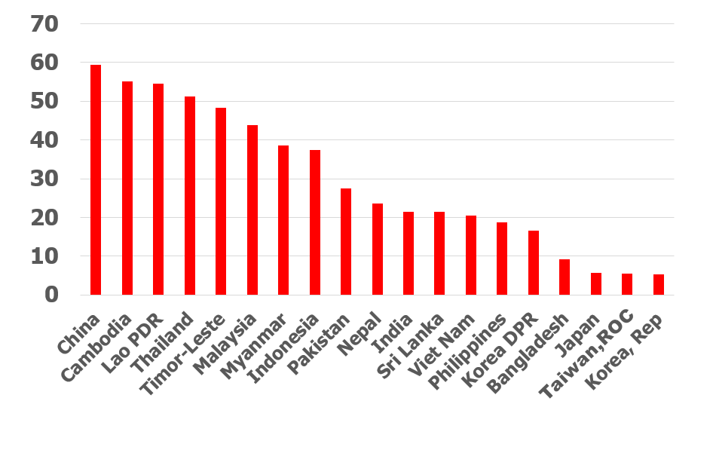
Agric land per capita is low in Asia (relative to the global average in 2018, where world = 100)

Slide 12
Transition in ag&food trade of DCs
Previous strong agricultural comparative advantage of DCs has fallen, converging on that of HICs

Slide 13
Converging indexes of ag. comparative advantage (% of ag & food in national merchandise exports as a ratio of ag+food share of global merchandise exports. Source: WDI)

Slide 14
Transition in ag&food trade of DCs
Previous strong agricultural comparative advantage of DCs has fallen, converging on that of HICs
& for many Asian countries, their rapid industrialization is leading them to gradually transition from net exporter to net importer of ag+food

Slide 15
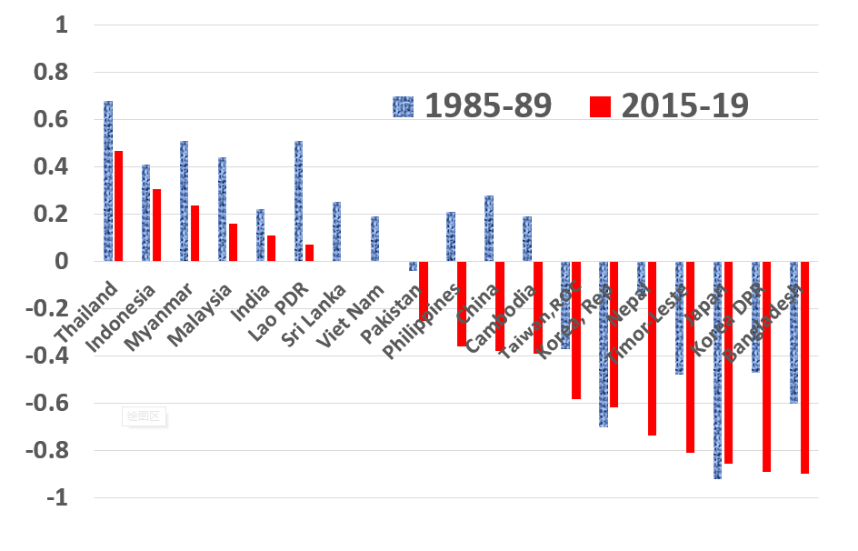
Agric trade specialization index Source: FAOSTAT [TSI = (X-M)/(X+M)]

Slide 16
Transition in ag&food trade of DCs
Meanwhile, DCs (incl. in SE Asia) have raised their share of global ag&food exports in the past three decades, from 45% to 60%
So they, in addition to reforming countries, would be beneficiaries of more-open global food markets

Slide 17
Developing countries’ shares (%) of world ag+food trade: imports pacing exports (Source: wits.worldbank.org, prepared by Will Martin)

Slide 18
Net exports of agric+food products, developing country regions ($US billion)

Slide 19
How open are food markets to international trade?

Slide 20
Globally, agric products are much less traded than are manufactures
Partly because global value chains have developed much faster for manufactures

Slide 21
Trade restrictions contribute to rel. low share of ag global exports as % of sectoral value added

Slide 22
Globally, agric products are much less traded than are manufactures
Partly because global value chains have developed much faster for manufactures
But also because import tariffs are lower & have fallen more for manufactures than for ag
… and the average agric import tariff for DCs is well above that for HICs

Slide 23
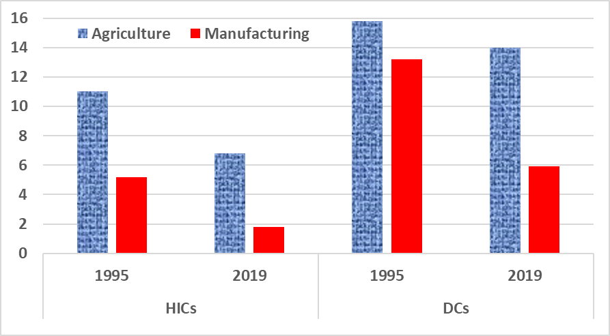
Import tariffs protecting agric & manufacturing, high-income and developing countries (%, from WTO)

Slide 24
Globally, agric products are much less traded than are manufactures
Partly because global value chains have developed much faster for manufactures
But also because import tariffs are lower & have fallen more for manufactures than for ag
… and average agric import tariff for DCs is well above that for HICs
& DC agric subsidies are growing also, esp. in Asia

Slide 25
Overall assistance to farmers (incl. exporters): falling in OECD, rising in emerging economies [nominal rate of assistance (NRA), %]

Slide 26
Overall assistance to farmers, 2018-20, US$ billion/year (Source: OECD 2021) China now > US+EU+Japan

Slide 27
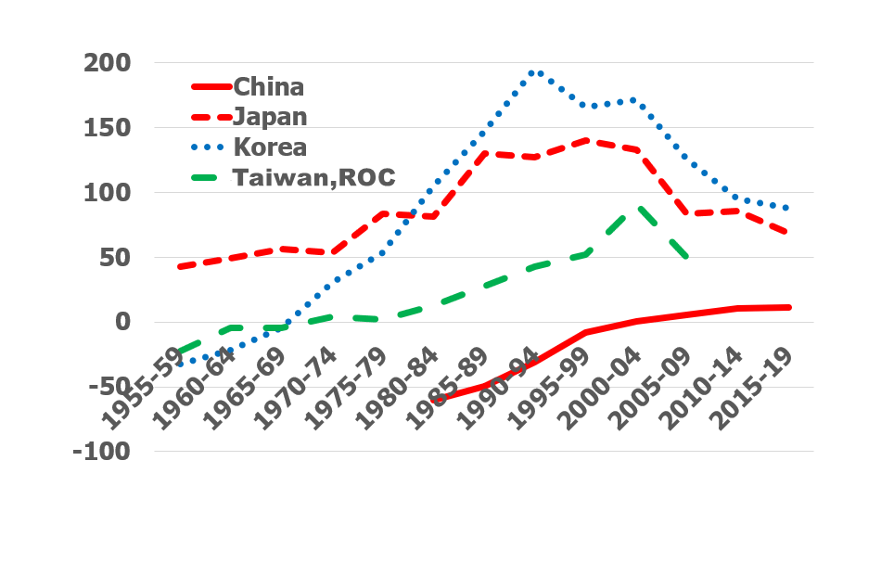
Rate of assistance to agric relative to other tradable sectors (RRA, %)

Slide 28
Farm product NRAs and CTEs, 2020 Source: OECD (2021)
Also, Asia’s producer and consumer support or tax equivalents vary a lot across products in each country
Due mainly to import restrictions
=> Inefficient producer resource allocation, distorts consumer choices (less variety, quality and off-season availability of fresh produce), and is inequitable (small farmers gain least, often hurts poorest buyers of food most)

Slide 29
China’s producer subsidy and consumer tax equivalents, 2020 (%) (Source: OECD (2021)

Slide 30
Assistance in India: very mixed, & has risen hugely since 2000 (Source: OECD 2021)
US$ billion per year | 2000-02 | 2018-20
Farm input subsidies (and income support) | 8 | 40
Farm output price support | -11 | -72
Total farmer support | -3 | -32
Food consumer support: | 15 | 96
* from farmers * from taxpayers | 11 4 | 65 31

Slide 31
Assistance in China vs India, 2018-20 (Source: OECD 2021)
US$ billion per year | China | India
Farm input subsidies (and income support) | 60 | 40
Farm output price support | 130 | -72
Total farmer support | 190 | -32
Food consumer support: | -136 | 96
* from farmers | -136 | 65

Slide 32
Negative assistance to some Asian agric export industries persists (Source: OECD, SCT < -10%)
India: rice, milk, beef, bananas
Indonesia: palm oil
Vietnam: chicken, coffee, rubber, tea
… while India subsidizes sugar exports

Slide 33
Also, food trade restrictions tend to vary year-on-year with international prices
e.g., when int’l food prices spike up, some DCs restrict ag exports (as in 2008), which raises int’l food prices further – and does not prevent poverty from rising (Anderson and Martin 2012)
and conversely when int’l prices slump

Slide 34
Rice NRA and international price, 82 countries, 1970–2020 (left axis is int’l price in current US$, right axis is wted average NRA (%))

Slide 35
As well, food trade restrictions vary inversely with international price
When int’l food prices spike, some DCs restrict ag exports (as in 2008), which raises int’l food prices further and does not prevent poverty from rising (Anderson and Martin 2012)
and conversely when int’l prices slump
We’re now seeing another food price spike, which is exacerbated (thanks partly to biofuel subsidies) by a rise in fossil fuel prices

Slide 36
Real int’l food & fossil fuel prices (World Bank, 2010 = 100)

Slide 37
How can Asia better achieve its national food security & related societal objectives?

Slide 38
… including building resilience to uncertainty affecting int’l agricultural competitiveness
Climate change: increasing volatility/extreme events; uncertain policy & technology responses
Disease epidemics: more frequent with globalization & meat consumption growth in DCs, & now COVID-19
New farm technologies:
Digital agriculture
Gene editing: adding to GMO policy uncertainty
More agric subsidies: US subsidies rose from 8% to 14% of US farm income during 2017-19 (OECD 2021)

Slide 39
Where to from here, multilaterally?
As with COVID, climate change and biodiversity, so with trade: multilateral cooperation is needed for optimal global solutions – to which China could contribute significantly
WTO provides good set of rules, disciplines & dispute settlement procedures for that purpose (Staiger 2021)
But the Dec. 2021 WTO Trade Ministerial meeting postponed
UN Food Systems Summit, 23 Sept 2021, has sought to stimulate transformation in food policies

Slide 40
Where to from here, multilaterally?
Since start of GATT Uruguay Round in 1986, HICs have halved their agric NRAs
But new pressures on national govts to transform/re-purpose their food policies to better achieve multiple societal objectives:
Environment (GHG emissions, biodiversity loss, water pollution from fertilizers, air/soil pollution from sprays: tax rather than subsidize some farm inputs such as Roundup?)
Animal welfare (intensive livestock spacing)
Human nutrition/obesity (tax meat, sugar consumption?)
Food safety & quality (supermarkets => GVCs)
Can lead HICs to restrict food imports (SPS, CBAMs)
So DCs also will be under pressure to transform food policies

Slide 41
Where to from here, multilaterally?
Whose farmers would benefit/lose if all of world’s agric subsidies and import tariffs were removed, as a first step on transforming food policies?
Farmers in most Asian DCs would gain
As would Indian farmers if their low farm output prices were raised to international levels

Slide 42
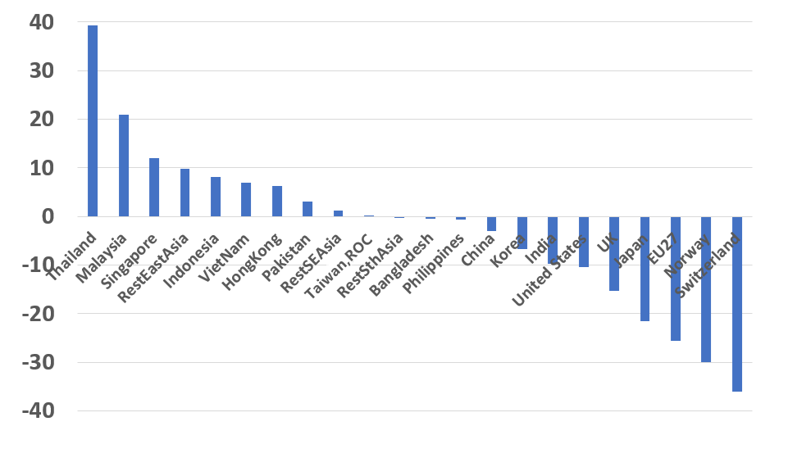
Impact on net farm incomes of removing all of world’s ag tariffs and farm subsidies, 2019 (%) (Source: GTAP model results by Anderson and Strutt (forthcoming Feb 2022)

Slide 43
Unilaterally, much scope for Asia to re-purpose supports to farm households
If more national food self-sufficiency is desired, extra investment in rural infrastructure and agric R&D would help
& also provides a high social payoff, in contrast to welfare cost of distortive agric tariffs & subsidies
China, India, Indonesia and Viet Nam spend <½ what Brazil and US spend on R&D per $ of farm output
Ag R&D could also focus on more-sustainable production, and safer & more nutritious food
with rapid results if modern biotech (GMO/GE) were to be fully exploited
If low rural incomes are a concern, invest more in rural education & health, & ease out-migration

Slide 44
Areas for further policy research
Complexity of finding optimal levels of intervention for numerous policy instruments multiplies greatly as the number of societal objectives and hence needed instruments rises
… and the welfare cost of deviating from the most appropriate instruments, or their optimal intervention levels, is becoming ever-more difficult to assess
Need better models to analyze the re-purposing of farmer assistance policies
… away from welfare-reducing and environment-damaging agric price supports and towards natural environment- and human health-enhancing measures

Slide 45
Areas for further policy research
Options to analyze empirically include:
enhanced investments in more-sustainable, climate-sensitive and nutrition-sensitive agric technologies
more-direct re-distributions of purchasing power to the poorest households as and when needed
boosts to consumer information that will nudge households towards a healthier diet based on food ingredients less damaging to the environment

Slide 46
Thanks! For more, see Anderson, K. (2021), “Food Policy in a More Volatile Climate and Trade Environment”, ANU Working Paper in Trade and Devt, forthcoming December. kym.anderson@adelaide.edu.au

