Slide 1
GMOs, CRISPR, Genomics and the Future of Asian Agriculture: 25 years and I’m still optimistic
Carl Pray

Slide 2
Can advances in biology transform Asian agriculture? Challenges are large
Food production
  Productivity growth
  Crises –
    Biological -Africa Swine Fever, corn stalk borer, fall armyworm, wheat rust
    Abiotic - extreme weather
  Climate change – global warming and drying slowing yield growth
Improved nutrition -
Pollution from agriculture and GHG emissions
Biomass to substitute for fossil resources for energy, chemicals, plastics, medicines

Slide 3
Opportunities for biological innovations also great
Non-GM crop and animal breeding efficiency is increasing by using genomics, molecular markers, big data and artificial intelligence.
GM crop opportunities for expanding current GM trait use and development of traits that don’t exist today’s commercial plants, animals and wild relatives are increasing due to advances in genomics, genetic engineering tools and big data.
CRISPR and other forms of gene editing also can improve plants and animals by efficiently knocking out harmful genes as well as producing GMOs more efficiently.
Advances in biology (limited discussion today)
  Microbiology: soil microbiome for better fertilizer, microbes for pest control
  COVID-19 induced advances understanding of viruses and resistance and vaccines, and medicines for virus prevention and control

Slide 4
Definitions
Conventional breeding = sexual reproduction using genes that exist in cultivated and wild species of crops or animals
Genome = all genetic information of an organism.
Genomics = the study of structure, function, evolution and mapping of genomes
Genetic engineering = “GMO” breeding by adding genes not available through sexual reproduction
  Bt – insect resistant GMO using Bacillus thuringiensis (Bt) gene
  Ht – herbicide tolerance GMO
Gene editing = more precise genetic engineering or mutating crops and animals using, say, CRISPR Cas9 to knock out harmful genes
Phenotype =the set of observable characteristics of an individual resulting from the interaction of its genotype with the environment.

Slide 5
Current Impact of Genomics, GMOs and CRISPR in Asia

Slide 6
GMOs are the main technique that has impacted Asian agriculture
India – 11 million Has. of Bt cotton, (2020 illegal Bt Ht cotton 20% of cotton area, HT soybeans, Bt eggplant)
China – 2.9 million Has. Bt cotton, disease resistant papaya, (2021 illegal Bt maize 3 million has according to seed industry)
Pakistan – 2.8 million Has. Bt cotton
Australia – 800,000 Has. HT canola, Bt cotton
Philippines – 600,000 Has. Bt maize, HT maize and stacked HT/Bt maize
Myanmar – 300,000 Bt cotton
Small areas of Bt maize in Vietnam, Bt Eggplant in Bangladesh
Source. ISAAA 2018 except for illegal spread which is from seed industry interviews.

Slide 7
Economic impact and environmental impact have been extensively document in India, Pakistan, China and Bangladesh
Transformed India’s cotton sector
  Farmers – increased yields, reduced pesticide use, increased income and social welfare (Matin Qaim various papers)
  Transform India from importer to major exporter of cotton.
Major impact on China’s cotton
  farmers – less pesticide use, small increase in yields, profits up
  cotton imports would have been higher without GMOs (Huang, Hu, Pray, Rozelle papers)
Impacts on maize production in Philippines similar (Alvarez et al 2021)
Bt eggplant in Bangladesh: yields up, pesticide down, increased income and health (Ahmed et al IFPRI 2019)
Notes:
Alvarez et al 2021

Slide 8
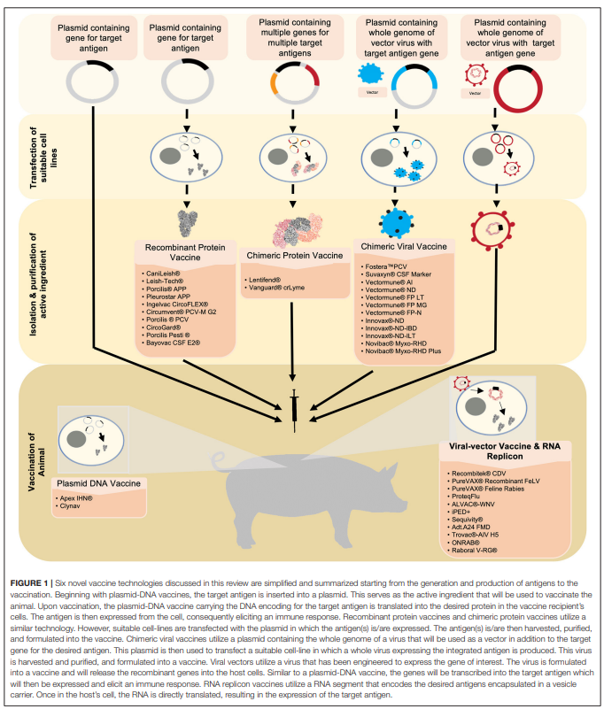
Possibly some impact of GMO vaccines for livestock in Asia: are used extensively in US & EU

Slide 9
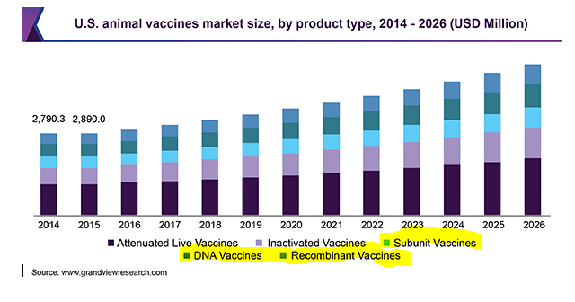
GMO Vaccines: Sales to 2018, then projections No studies of impact

Slide 10
Genomics and big data are the basis of plant breeding programs of Corteva, Bayer, Syngenta and BASF
China maize
Bayer (formerly Monsanto) in partnership with China National Seed Group (Sinoseeds) has developed a series of very productive disease and lodging resistant maize hybrids – ranks 1 in market share
Corteva (formerly Pioneer/DuPont) is developing a new group of high yielding maize hybrids to replace their hybrids (335) which were most popular with 20% of the market – number 2
Syngenta making major investment in research in China – was number 3 (recently merged with Sinoseed)
India
CORTEVA, Bayer, and Syngenta are developing hybrid maize (and hybrid rice???) using these techniques and selling maize seed in India.
Philippines
CORTEVA and Bayer produce maize hybrids

Slide 11
Case Study: Genus PLC research uses Genomics and Information science to improve swine, diary and meat cattle
Headquarters in U.K.; sales of genetics is global; in recent years China has been their largest swine market
Biggest swine breeder globally 17% of market, 2nd biggest cattle for diary and meat with 9%.
New tools
  GENOME SCIENCE AND BIOINFORMATICS: understanding the links between DNA and animals’ observable characteristics, and how we can influence them
  GENOMIC SELECTION breeding successive generations of animals by using DNA analysis to select superior parents in our breeding herds
Source: Genus website https://www.genusplc.com/

Slide 12
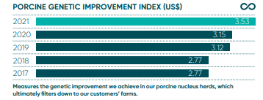
Steady increase of swine productivity in experiment stations based on genomics and information technology
Source: Genus website https://www.genusplc.com/
China the biggest market for Genus conventional swine genetics.

Slide 13
Genome and big data based breeding not used extensively in public sector and local research firms in Asia
Constraints to its use in plant breeding are:
Narrow gene pool due to limited access to germplasm materials with diverse background.
Continued dominance of conventional breeding methods, due to lack of high throughput, high efficiency and automated phenotypic platforms.
Lack of capabilities in bioinformatics analysis and managing big data.
Ren Wang 2021 https://www.youtube.com/watch?v=npexYYsnW1k

Slide 14
CRISPR and other Gene editing tools are being used extensively in research, but no gene-edited crops approved for commercial use in Asia yet

Slide 15
Future use of new tools in conventional breeding, GMOs and gene-editing in Asian agriculture

Slide 16
Modern breeding technology is likely to have an important impact in this decade
Private plant and animal breeding will expand the use these techniques
  Hybrids like maize and rice and GMOs like cotton but not self pollinated crops like wheat and most rice.
  They will benefit from public research on genomics and advances in I.T.
  Smaller, local firms will benefit from training and linkages with national and international genomics programs
  Not limited by GMO regulations
Public sector breeding programs likely to grow rapidly in Asia due to public investments in research on genomics and application of big data.
  Public sector breeders don’t want to deal with the GMO regulations
  India and China have major national programs
  CGIAR centers are promoting it through out Asia

Slide 17

The Chinese government has made major investments to strengthen genomics capacity in China and globally.
New China National Gene Bank in Shenzhen

Slide 18
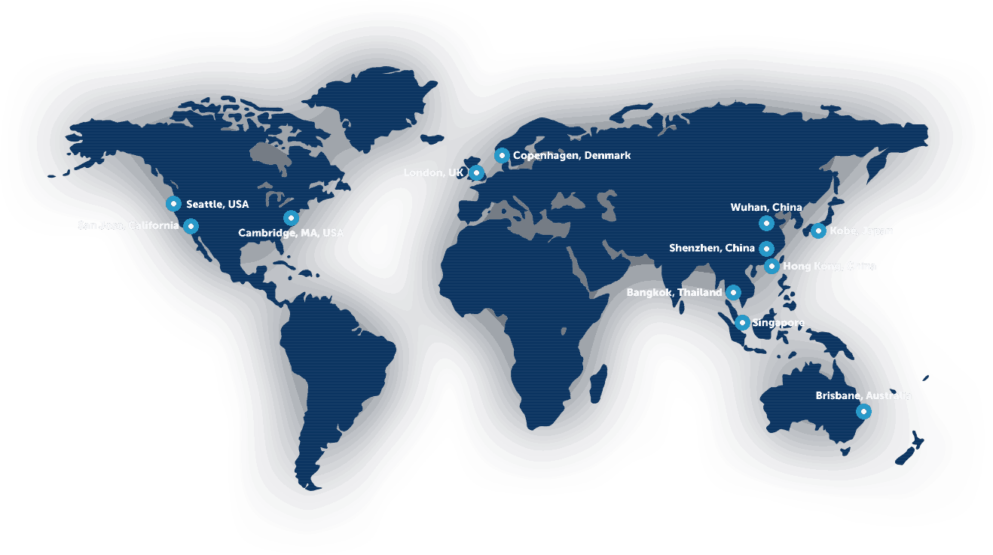
It partners with BGI, world’s largest genome sequencing company. Headquarters Shenzhen, China – labs and offices global

Slide 19
Partnership between BGI and CNGB will strengthen conventional breeding
Digitalization of crop germplasm material to develop digital sequencing information platforms with big data which are publicly available
Provide high throughput and low-cost sequencing and data mining/analyses services while building data analyses capabilities of breeders
Sequencing and bioinformatics support to high throughput phenotyping platform – combining genotyping with phenotyping.

Slide 20
Genomics and big data likely to increase Indian public and private breeding & impacts
ICAR-BMGF project to modernize Indian plant breeding genomics and big data started in 2019
ICRISAT is leading a major chickpea genomic sequencing program and Indian scientists are linked up with IRRI’s rice genomics program and CIMMYT’s maize genomics.
the Ministry of Science and Technology’s (MOST) Department of Biotechnology (DBT) supports programs developing of genome-wide analysis and engineering technologies
Private firms already benefitting from improved knowledge about pearl millet, sorghum, maize, rice and perhaps chickpea genomes
  These crops are attractive because hybrid seeds are important (except chickpea)

Slide 21
Asian countries who do not have major government programs on genomics can access training and genomic information & tools through:
BGI and CNGB programs on rice with IRRI and orphan crops with many partners.
International centers such as IRRI, ICRISAT, CIMMYT, and CIAT for major grain crops
MNCs bring in the technology for crops they are interested in: maize, hybrid rice, soybeans..

Slide 22
Future of GMOs in Asia: A few signs of change in regulatory policies in China, Philippines is approving GMOs – first in rice. Others stuck.
China – so far GM cotton and papaya
  Just completed 2006-2020, $3.5 billion research project to develop GMOs for 5 crops and 3 animals produced Chinese (not foreign) traits
  Has developed a specific regulatory pathway for the commercialization of GM maize – last part November 2021
  Has not stopped the planting of unapproved Bt maize on millions of Has. in NE China which have major problems with corn borer and fall army worm.
  COVID and trade disputes put pressure for more self sufficiency in maize
  BUT still no final approval for cultivation Bt maize, keeping it for emergencies???
India – GM cotton
  Indian seed companies shutting down biotech labs, shifting back to conventional
  Public sector breeders shifting to genomics and I.T. to produce conventional varieties
  Two somewhat positive signs
    Allowing imports of GM soybeans for feed and oil
    Have allowed extensive cultivation of illegal HT/Bt stacked cotton.

Slide 23
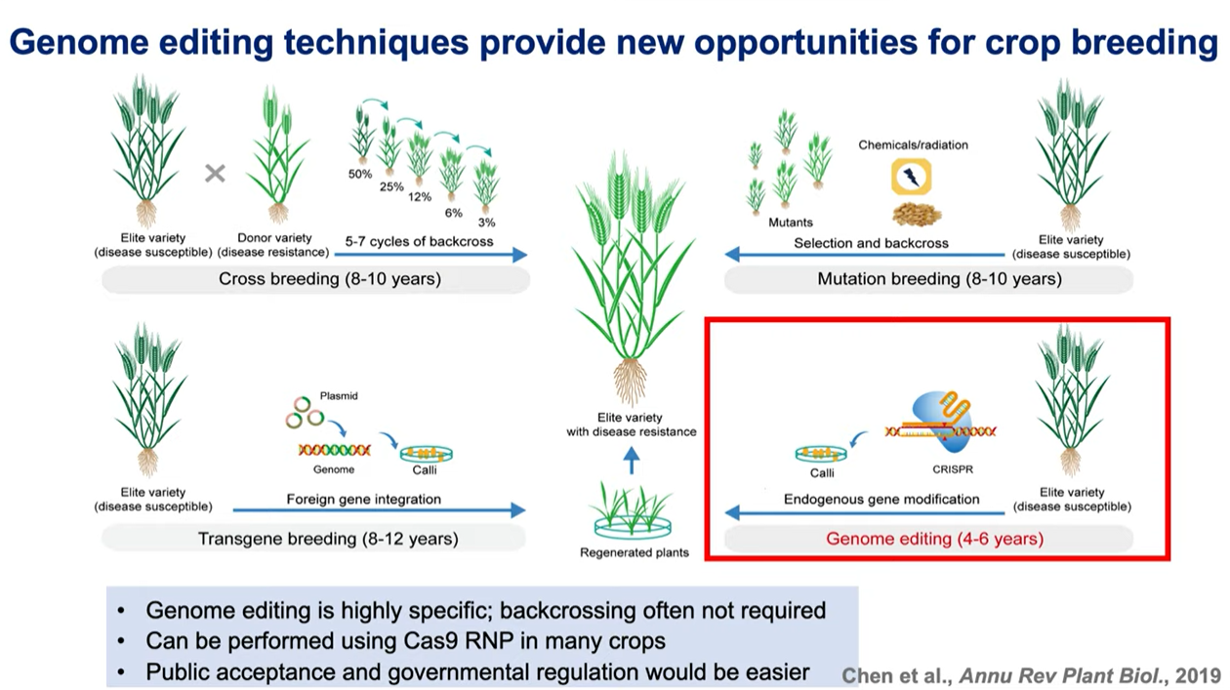

Slide 24
China the leader after U.S.(plants developed using new gene editing techniques at the market or pre-market stage)
Source: Parisi and Rodriquez-Cerezo (2021).

Slide 25
Oil or grain quality, pest & disease stress, and yields the main characteristics in the pipeline
Source: Parisi and Rodriquez-Cerezo (2021).

Slide 26
Cereals the major target with rice the leader

Slide 27
Global Patenting
Figure 3. Top Filers of CRISPR Plant Agriculture: Published Patents and/or Patent Applications Worldwide (as of January 2021
Bagley 2021

Slide 28
Corteva is leader in use of CRISPR outside of China
Agreement with Caribou Genetics in 2015 for CRISPR-Cas9 for cross licensing
Developed a waxy maize variety, bring it to US regulators in 2015 and regulators determined that it does not need to be regulated as a GMO
  Still not available to farmers
Using it extensively in their research but have not commercialized any gene-edited varieties
Added CRISPR patents from Broad Institute and Harvard and now bundling and licensing to others like IRRI, ICRISAT and Bejo Seeds in Netherlands

Slide 29
Corteva plays an important role in bundling and licensing crop uses of CRISPR Cas9 an provide it Asian public sector and MNCs.

Slide 30
Genus development of CRISPR Pigs for disease resistance.
Licensed CRISPR-Cas9 from Caribou biotech in 2015
Spent $7 million on CRISPR research in 2021
Used CRISPR to develop swine varieties resistant to disease.
  Developed varieties resistant to two strains of porcine reproductive and respiratory syndrome virus (PRRSV)
  Have made two applications for PRRSV varieties to be commercialization to USFDA
  Have gone into a collaboration with Beijing Capital Agribusiness (BCA) to register PRRSV with the Chinese government and further develop this pig variety.
Working with Kansas State and others to evaluate their lines for resistance to African Swine Fever

Slide 31
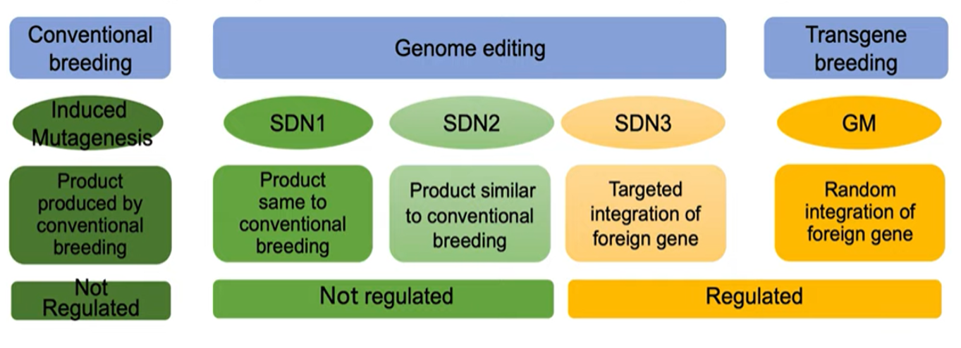
Regulatory framework for gene-edited crops in US vs Europe
EU regulations
US regulations

Slide 32
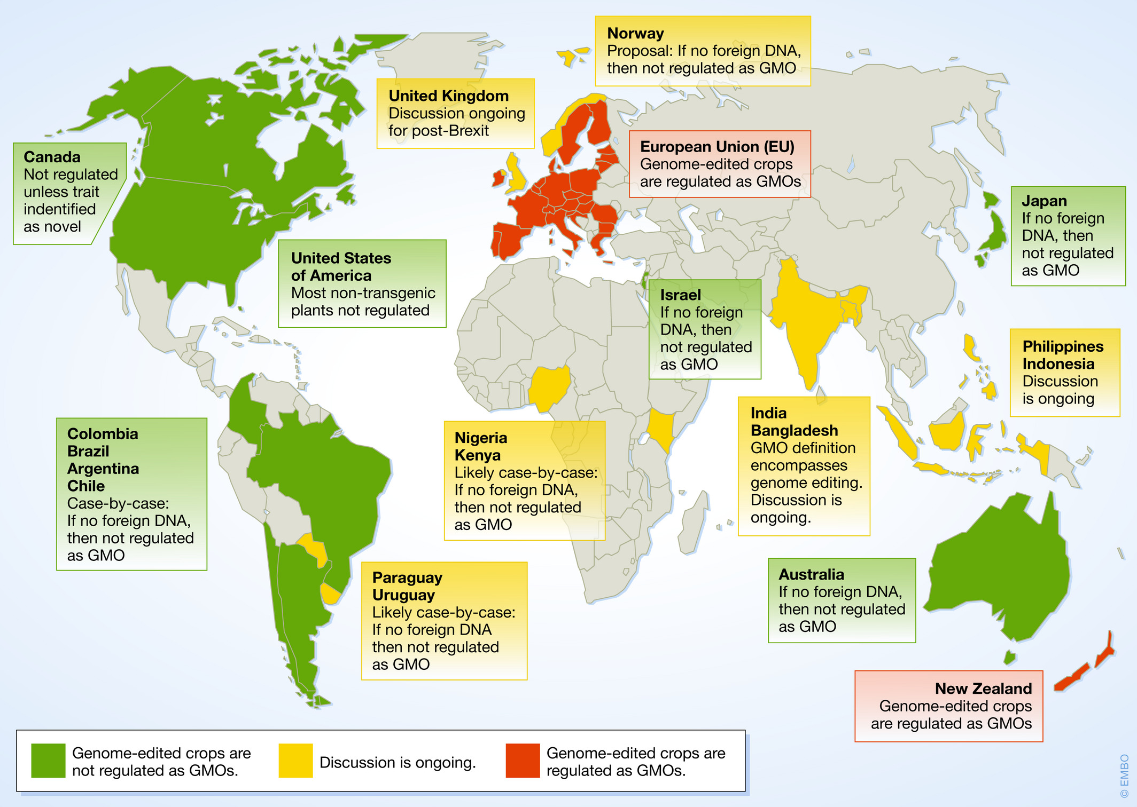
Current state of gene editing regulation 2020: Green cheaper & faster, Red same as GMOs
https://www.embopress.org/doi/full/10.15252/embr.202050680

Slide 33
The Future Use & Impacts of Biotech in Asia
 | Advantage | Time & cost saving over current breeding (plants) | Potential impact on production & environment | Public or private research | Needed policy changes
Modern breeding | Speeds & increases efficiency of breeding; limited by genome of targeted plant | 2-3 years less parent selection& backcrossing, but major investment in IT, training, genomics. No new regs or consumer resistance | Faster yield gains & resistance to biotic & abiotic stress to gradually reduce chemicals | Big private is using for hybrids; Public & local private in future self pollinated | More funds for genomics & training
GMO plants animals, vaccines | Allows addition of trait not genome of target plant | 2 years more than conventional breeding then 3 or more years for regulation and consumer resistance | Tech available for yield gains & stress resistance. Replace pesticides | Big & small private firms, for major feed & industrial crops. | Transparent regulatory process with path to commerciali-zation
Gene editing | Knock out multiple genes efficiently. | Saves 2 or 3 years, inexpensive inputs for use. Needs genomics. Regulation?? Consumer resistance??? | Some tech ready - Quality, disease resistance, then yield. | Small/big firms hort. & pulses; big firms & public non-GMO field crops | Clarify regulations on gene editing without foreign genes. More funds for research

Slide 34
Future of Asian crop agriculture
The productivity of conventional breeding will increase due to genomics, phenomics, big data and A.I. – depends on government investment in research, access and training.
  Major public investments in research are underway in national and international programs in Asia
  Spreads through large private MNC firms in crops like corn, soybeans
  No new regulations, consumers don’t object yet
  Limits – restricted to traits in crop’s genome or wild relatives; slow response to climate change, etc…

Slide 35
Future of Asian crop agriculture
Will GMOs spread in Asia? Depends on regulation
  First - industrial uses (cotton) and animal feed (corn and soy)
  Second – Americans, Asians & Africans accept GMO food crops (Bt/Ht white maize in South Africa, disease-resistant papaya China, Bt eggplant in Bangladesh and golden rice in Philippines)
Will CRISPR spread in Asia? Depends on science & regulation
  Major investments in CRISPR R&D development in China – less elsewhere in Asia.
  IRRI and ICRISAT have licensed CRISPR
  MNCs have licensed and are using it in their research.
  – will it be regulated as GMO?

Slide 36
Thanks and I look forward to your comments and questions

Slide 37
Extra slides

Slide 38
Impact of Pandemic on Funding of Research and Innovation
Moderate declines in research and innovation productivity
  Due to travel restrictions, shut down of labs, etc.
  Also, problems (travel and sickness) of workers in fields and experiment stations.
Some national systems were already having financial problems and pandemic made it worse.
  S. Africa 20% down; EMBRAPA in Brazil down 18%, India flat
  China and maybe US up
Private
  Large OECD based firms’ R&D down in 2021 compared to 2020.
  But some large firms in machinery, seeds and chemicals based in Zimbabwe, India and China seem to be increasing their research.

Slide 39
New technological opportunities due to pandemic?
Technological opportunities that were growing before pandemic have been accelerated during the pandemic – genomics, CRISPR, big data
Development of more efficient research tools – for example more efficient gene editing with CRISPR – can be used in agricultural research
Billions of dollars in biological research on viruses, vaccines, therapeutics
    Spillovers: Some ILRI scientist believe the new platforms such as mRNA for vaccines such as African Swine Fever which has not been responsive to other types of vaccines

Slide 40
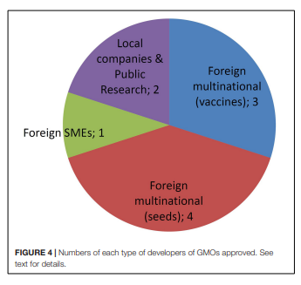
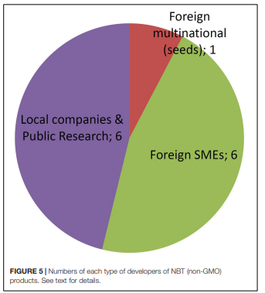
CRISPR impact on biotech industry: smaller firms can enter market - Argentina
Gene edited crop applications
GMOs approved by type of firm

